Slide 1
Tools for Machine Learning CISC7202
Prof. Weijia Jia (賈維嘉) E11-4007
Office hour: Wednesday 2—5pm/E11-4007/N21-1014
Email: jiawj@umac.mo
https://www.fst.um.edu.mo/en/staff/jiawj.html

Slide 2
Introduction to Machine Learning

Slide 3
Introduction to Machine Learning
https://towardsdatascience.com/coding-deep-learning-for-beginners-types-of-machine-learning-b9e651e1ed9d

Slide 4
Why “Learn”?
Machine learning is programming computers to optimize a performance criterion using example data or past experience.
There is no need to “learn” to calculate payroll
Learning is used when:
Human expertise does not exist (navigating on Mars),
Humans are unable to explain their expertise (speech recognition)
Solution changes in time (routing on a computer network)
Solution needs to be adapted to particular cases (user biometrics)

Slide 5
What We Talk About When We Talk About“Learning”
Learning general models from a data of particular examples
Data is cheap and abundant (data warehouses, data marts); knowledge is expensive and scarce.
Example in retail: Customer transactions to consumer behavior:
People who bought “Da Vinci Code” also bought “The Five People You Meet in Heaven” (www.amazon.com)
Build a model that is a good and useful approximation to the data.

Slide 6
Data Mining/KDD
Definition := “KDD is the non-trivial process of identifying valid, novel, potentially useful, and ultimately understandable patterns in data” (Fayyad)
Applications:
Retail: Market basket analysis, Customer relationship management (CRM)
Finance: Credit scoring, fraud detection
Manufacturing: Optimization, troubleshooting
Medicine: Medical diagnosis
Telecommunications: Quality of service optimization
Bioinformatics: Motifs, alignment
Web mining: Search engines
...

Slide 7
What is Machine Learning?
Machine Learning
Study of algorithms that improve their performance at some task with experience
Optimize a performance criterion using example data or past experience.
Role of Statistics: Inference from a sample
Role of Computer science: Efficient algorithms to
Solve the optimization problem
Representing and evaluating the model for inference

Slide 8
Growth of Machine Learning
Machine learning is preferred approach to
Speech recognition, Natural language processing
Computer vision
Medical outcomes analysis
Robot control
Computational biology
This trend is accelerating
Improved machine learning algorithms
Improved data capture, networking, faster computers
Software too complex to write by hand
New sensors / IO devices
Demand for self-customization to user, environment
It turns out to be difficult to extract knowledge from human experts → failure of expert systems in the 1980’s.

Slide 9
Applications
Association Analysis
Supervised Learning
Classification
Regression/Prediction
Unsupervised Learning
Reinforcement Learning

Slide 10
Learning Associations
Basket analysis:
P (Y | X ) probability that somebody who buys X also buys Y where X and Y are products/services.
Example: P ( chips | beer ) = 0.7
Market-Basket transactions

Slide 11
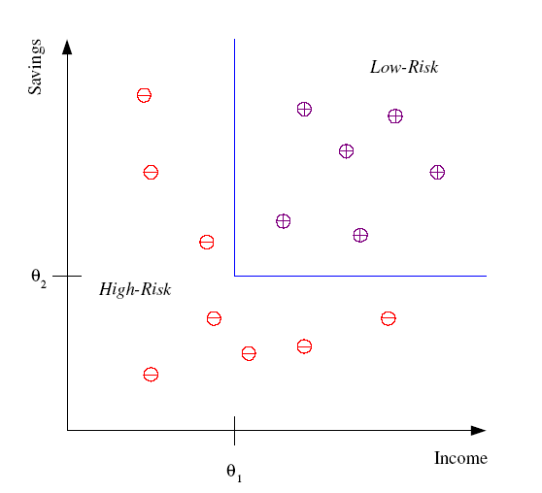
Classification
Example: Credit scoring
Differentiating between low-risk and high-risk customers from their income and savings
Discriminant: IF income > θ₁ AND savings > θ₂
THEN low-risk ELSE high-risk
Model

Slide 12
Classification: Applications
Aka Pattern recognition
Face recognition: Pose, lighting, occlusion (glasses, beard), make-up, hair style
Character recognition: Different handwriting styles.
Speech recognition: Temporal dependency.
Use of a dictionary or the syntax of the language.
Sensor fusion: Combine multiple modalities; e.g., visual (lip image) and acoustic for speech
Medical diagnosis: From symptoms to illnesses
Web Advertising: Predict if a user clicks on an ad on the Internet.

Slide 13








Face Recognition
Training examples of a person
Test images
AT&T Laboratories, Cambridge UK
http://www.uk.research.att.com/facedatabase.html

Slide 14
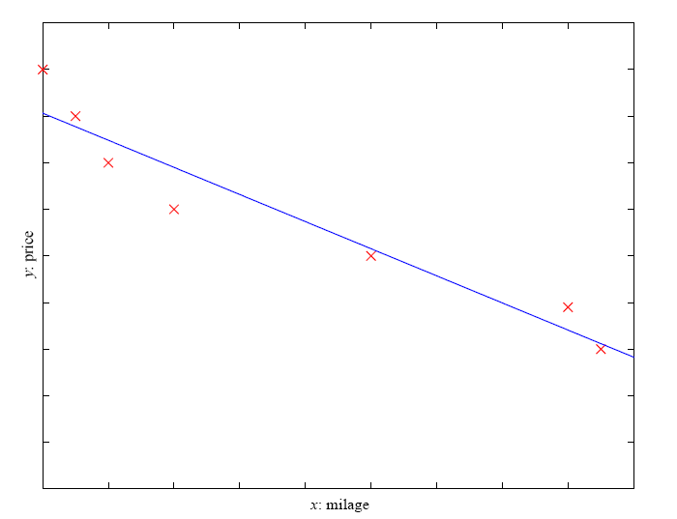
Prediction: Regression
Example: Price of a used car
x : car attributes
y : price
y = g (x | θ )
g ( ) model,
θ parameters
y = wx+w₀

Slide 15
Regression Applications
Navigating a car: Angle of the steering wheel (CMU NavLab)
Kinematics of a robot arm
(x,y)
α₁= g₁(x,y)
α₂= g₂(x,y)
α₂
α₁

Slide 16
Supervised Learning: Uses
Example: decision trees tools that create rules
Prediction of future cases: Use the rule to predict the output for future inputs
Knowledge extraction: The rule is easy to understand
Compression: The rule is simpler than the data it explains
Outlier detection: Exceptions that are not covered by the rule, e.g., fraud

Slide 17
Unsupervised Learning
Learning “what normally happens”
No output
Clustering: Grouping similar instances
Other applications: Summarization, Association Analysis
Example applications
Customer segmentation in CRM
Image compression: Color quantization
Bioinformatics: Learning motifs

Slide 18
Reinforcement Learning
Topics:
Policies: what actions should an agent take in a particular situation
Utility estimation: how good is a state (→used by policy)
No supervised output but delayed reward
Credit assignment problem (what was responsible for the outcome)
Applications:
Game playing
Robot in a maze
Multiple agents, partial observability, ...

Slide 19
Resources: Datasets
UCI Repository: http://www.ics.uci.edu/~mlearn/MLRepository.html
UCI KDD Archive: http://kdd.ics.uci.edu/summary.data.application.html
Statlib: http://lib.stat.cmu.edu/
Delve: http://www.cs.utoronto.ca/~delve/

Slide 20
Resources: Journals
Journal of Machine Learning Research www.jmlr.org
Machine Learning
IEEE Transactions on Neural Networks
IEEE Transactions on Pattern Analysis and Machine Intelligence
Annals of Statistics
Journal of the American Statistical Association
...

Slide 21
Resources: Conferences
International Conference on Machine Learning (ICML)
European Conference on Machine Learning (ECML)
Neural Information Processing Systems (NIPS)
Computational Learning
International Joint Conference on Artificial Intelligence (IJCAI)
ACM SIGKDD Conference on Knowledge Discovery and Data Mining (KDD)
IEEE Int. Conf. on Data Mining (ICDM)

Slide 22
A Short History of Machine Learning -- Every Manager Should Read Bernard Marr
Machine Learning is a sub-set of artificial intelligence where computer algorithms are used to autonomously learn from data and information. In machine learning computers don’t have to be explicitly programmed but can change and improve their algorithms by themselves.
https://www.forbes.com/sites/bernardmarr/2016/02/19/a-short-history-of-machine-learning-every-manager-should-read/#76e3e8c15e78

Slide 23
A Short History of Machine Learning -- Every Manager Should Read Bernard Marr
Today, machine learning algorithms enable computers to communicate with humans, autonomously drive cars, write and publish sport match reports, and find terrorist suspects.
I firmly believe machine learning will severely impact most industries and the jobs within them, which is why every manager should have at least some grasp of what machine learning is and how it is evolving.
https://www.forbes.com/sites/bernardmarr/2016/02/19/a-short-history-of-machine-learning-every-manager-should-read/#76e3e8c15e78

Slide 24
A Short History of Machine Learning
1950 — Alan Turing creates the “Turing Test” to determine if a computer has real intelligence. To pass the test, a computer must be able to fool a human into believing it is also human.
1952 — Arthur Samuel wrote the first computer learning program. The program was the game of checkers, and the IBM IBM -1.25% computer improved at the game the more it played, studying which moves made up winning strategies and incorporating those moves into its program.
1957 — Frank Rosenblatt designed the first neural network for computers (the perceptron), which simulate the thought processes of the human brain.
https://www.forbes.com/sites/bernardmarr/2016/02/19/a-short-history-of-machine-learning-every-manager-should-read/#76e3e8c15e78

Slide 25
A Short History of Machine Learning
1967 — The “nearest neighbor” algorithm was written, allowing computers to begin using very basic pattern recognition. This could be used to map a route for traveling salesmen, starting at a random city but ensuring they visit all cities during a short tour.
1979 — Students at Stanford University invent the “Stanford Cart” which can navigate obstacles in a room on its own.
1981 — Gerald Dejong introduces the concept of Explanation Based Learning (EBL), in which a computer analyses training data and creates a general rule it can follow by discarding unimportant data.
https://www.forbes.com/sites/bernardmarr/2016/02/19/a-short-history-of-machine-learning-every-manager-should-read/#76e3e8c15e78

Slide 26
A Short History of Machine Learning
1985 — Terry Sejnowski invents NetTalk, which learns to pronounce words the same way a baby does.
1990s — Work on machine learning shifts from a knowledge-driven approach to a data-driven approach. Scientists begin creating programs for computers to analyze large amounts of data and draw conclusions — or “learn” — from the results.
1997 — IBM’s Deep Blue beats the world champion at chess.
2006 — Geoffrey Hinton coins the term “deep learning” to explain new algorithms that let computers “see” and distinguish objects and text in images and videos.
https://www.forbes.com/sites/bernardmarr/2016/02/19/a-short-history-of-machine-learning-every-manager-should-read/#76e3e8c15e78

Slide 27
A Short History of Machine Learning
2010 — The Microsoft Kinect can track 20 human features at a rate of 30 times per second, allowing people to interact with the computer via movements and gestures.
2011 — IBM’s Watson beats its human competitors at Jeopardy.
2011 — Google Brain is developed, and its deep neural network can learn to discover and categorize objects much the way a cat does.
https://www.forbes.com/sites/bernardmarr/2016/02/19/a-short-history-of-machine-learning-every-manager-should-read/#76e3e8c15e78

Slide 28
A Short History of Machine Learning
2012 – Google’s X Lab develops a machine learning algorithm that is able to autonomously browse YouTube videos to identify the videos that contain cats.
2014 – Facebook develops DeepFace, a software algorithm that is able to recognize or verify individuals on photos to the same level as humans can.
2015 – Amazon launches its own machine learning platform.
https://www.forbes.com/sites/bernardmarr/2016/02/19/a-short-history-of-machine-learning-every-manager-should-read/#76e3e8c15e78

Slide 29
A Short History of Machine Learning
2015 – Microsoft creates the Distributed Machine Learning Toolkit, which enables the efficient distribution of machine learning problems across multiple computers.
2015 – Over 3,000 AI and Robotics researchers, endorsed by Stephen Hawking, Elon Musk and Steve Wozniak (among many others), sign an open letter warning of the danger of autonomous weapons which select and engage targets without human intervention.
2016 – Google’s artificial intelligence algorithm beats a professional player at the Chinese board game Go, which is considered the world’s most complex board game and is many times harder than chess. The AlphaGo algorithm developed by Google DeepMind managed to win five games out of five in the Go competition.
https://www.forbes.com/sites/bernardmarr/2016/02/19/a-short-history-of-machine-learning-every-manager-should-read/#76e3e8c15e78

Slide 30
Why Machine Learning?
Machine learning is a means of realizing artificial intelligence. Its main research content is how to use data or experience to learn and improve the performance of specific algorithms.
Multi-domain intersection, involving multiple disciplines such as probability theory, statistics, algorithm complexity theory, etc.
Widely used in web search, spam filtering, recommendation system, advertising, credit evaluation, Fraud detection, stock trading, and medical diagnostics applications.

Slide 31
Goals of Machine Learning
First, we will introduce the basic concepts of ML.
Throughout the course, basic ML tool: Scikit-learn (sklearn), will be be emphasized on some basic learning process.
ML overview, inductive learning, and representation (or reinforcement) learning will be introduced. Basic learning processes of Bayesian Networks will be studied;
Deep learning and deep neural networks; convolution neural network.
Other practical methodology of using tools: Karas/Tensorflow etc. will be be introduced.
Finally, we will introduce the basic concepts such as liner algebra; probability and information theory, and numerical methods.

Slide 32
Basic Categories of Machine Learning
Machine learning is generally divided into the following categories:
Supervised Learning
Unsupervised Learning
Reinforcement Learning
Representation Learning
Semi-supervised Learning
Deep Learning

Slide 33
Python Scikit-learn
Machine Learning in Python:
Scikit-learn (sklearn): http://scikit-learn.org/stable/
A simple and effective set of tools
Depends on Python's NumPy, SciPy and matplotlib libraries
Open source, reusable

Slide 34
Common Function in Scikit-learn
 | Applications | Algorithm
Classification | Anomaly detection, image recognition, etc. | KNN, SVM, etc.
Clustering | Image segmentation, group segmentation, etc. | K-Means, etc.
Regression | Price forecast, trend forecast, etc. | Linear regression, SVR，etc.
Dimension Reduction | Visualization | PCA，NMF，etc.

Slide 35
Our Course Objectives
Understand basic machine learning principles and algorithms
Learn the ability to solve application problems with machine learning algorithms
Master the basic method of common machine learning algorithms in the sklearn library

Slide 36
Related Reference Books

Slide 37
Book -《PRML》- Bishop
Publishing house: Springer
Homepage: http://t.cn/RXv0YVz
Review: “早知此书，PhD早毕业2年”

Slide 38
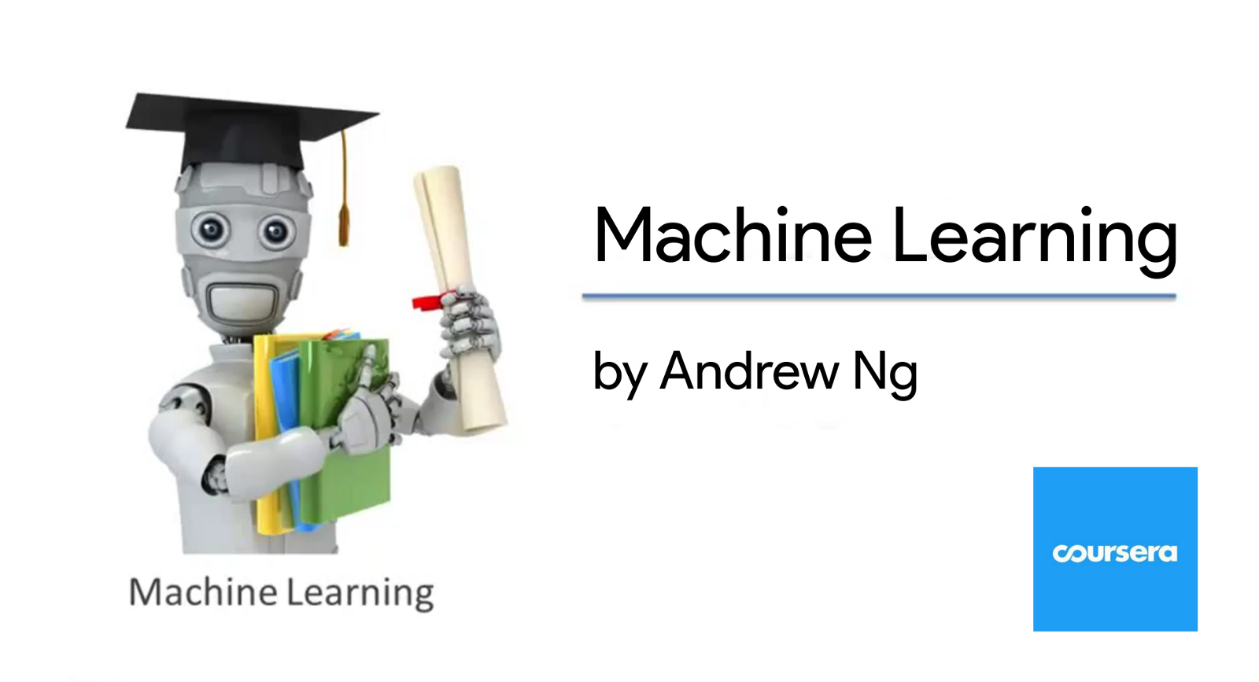
Course - 《Machine Learning》- Andrew Ng
Coursera Course Page:
http://t.cn/RJZQbV2
Stanford Course Page:
http://cs229.stanford.edu/

Slide 39
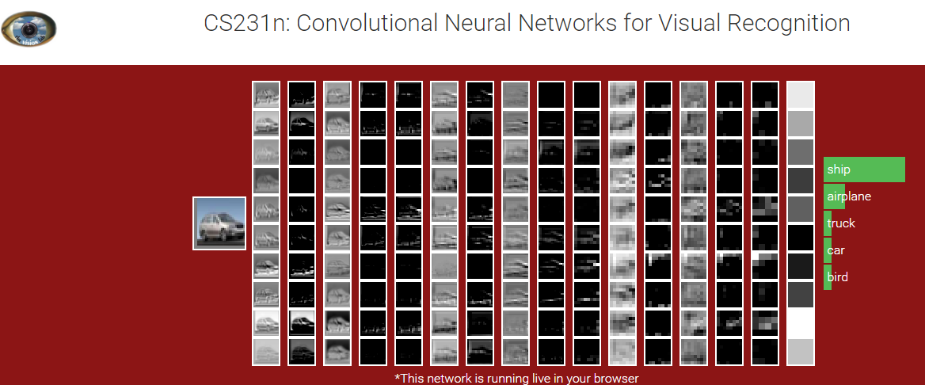
Course - 《CS231n》- Fei-Fei Li
Course Page:
http://cs231n.stanford.edu/

Slide 40
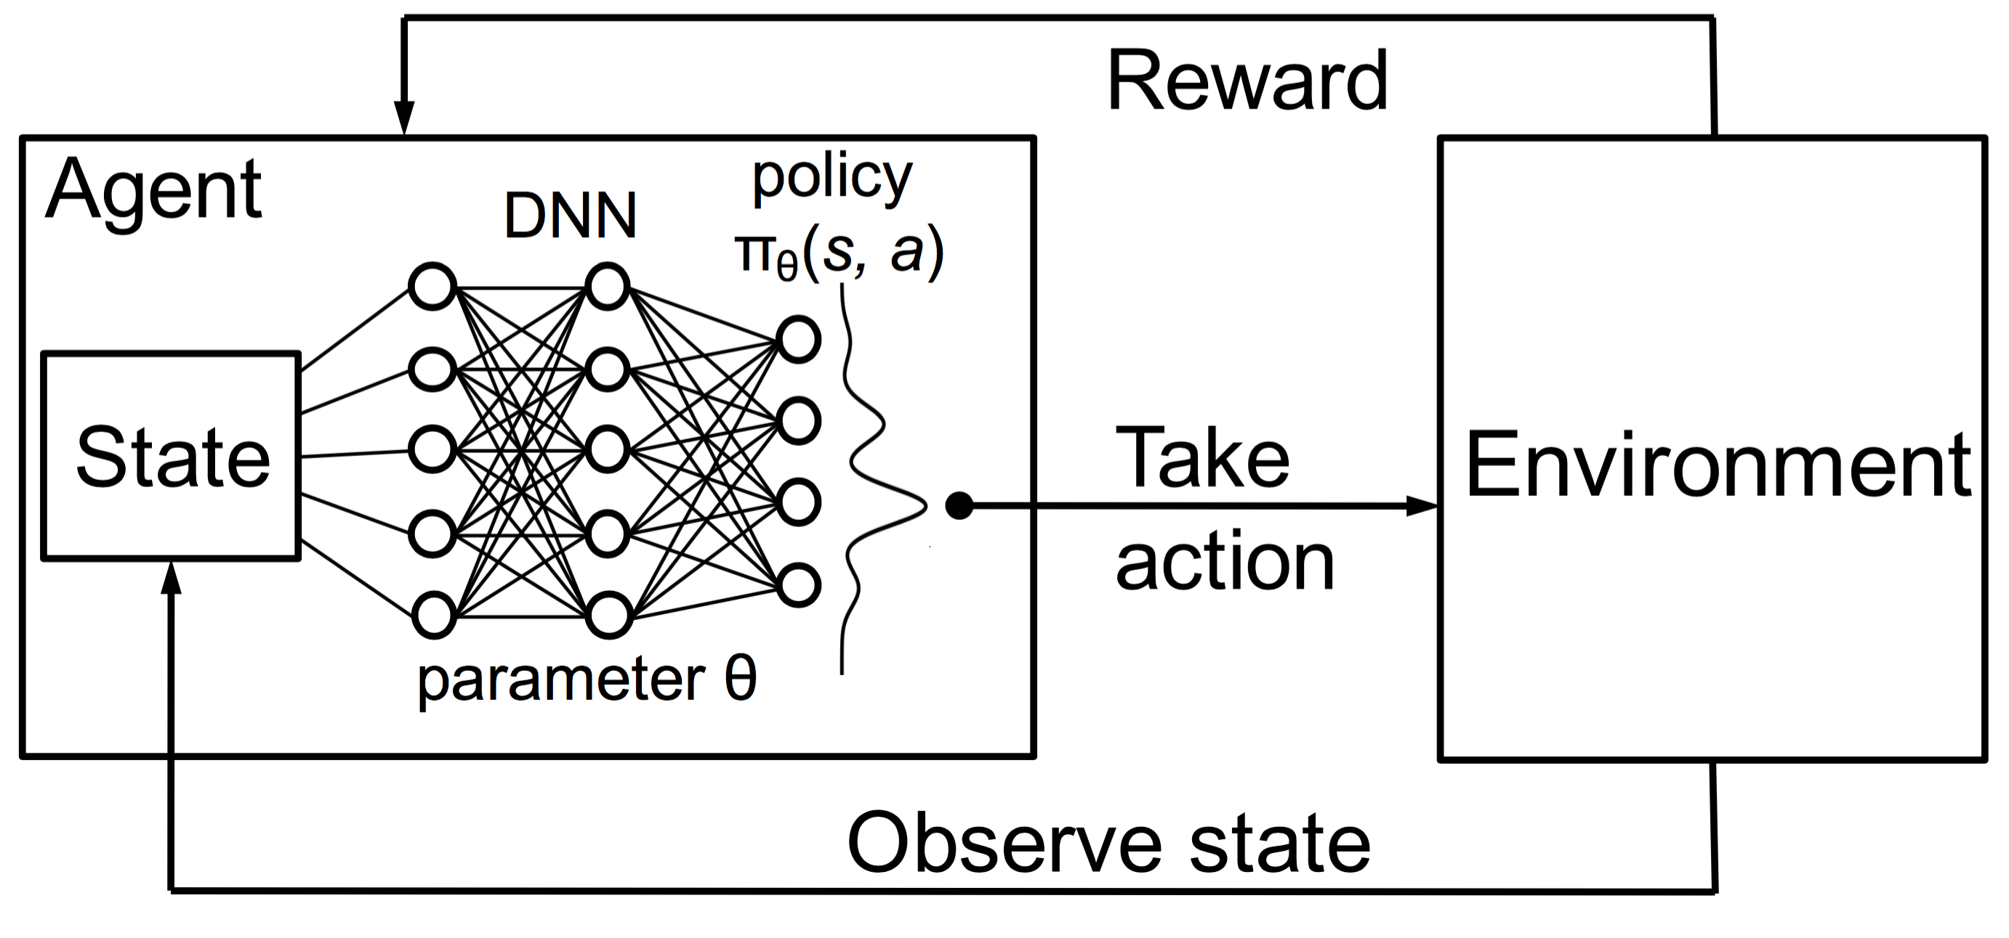
Course - 《Reinforcement Learning》- David Silver
Course Page:
http://t.cn/Rw0rwtU

Slide 41
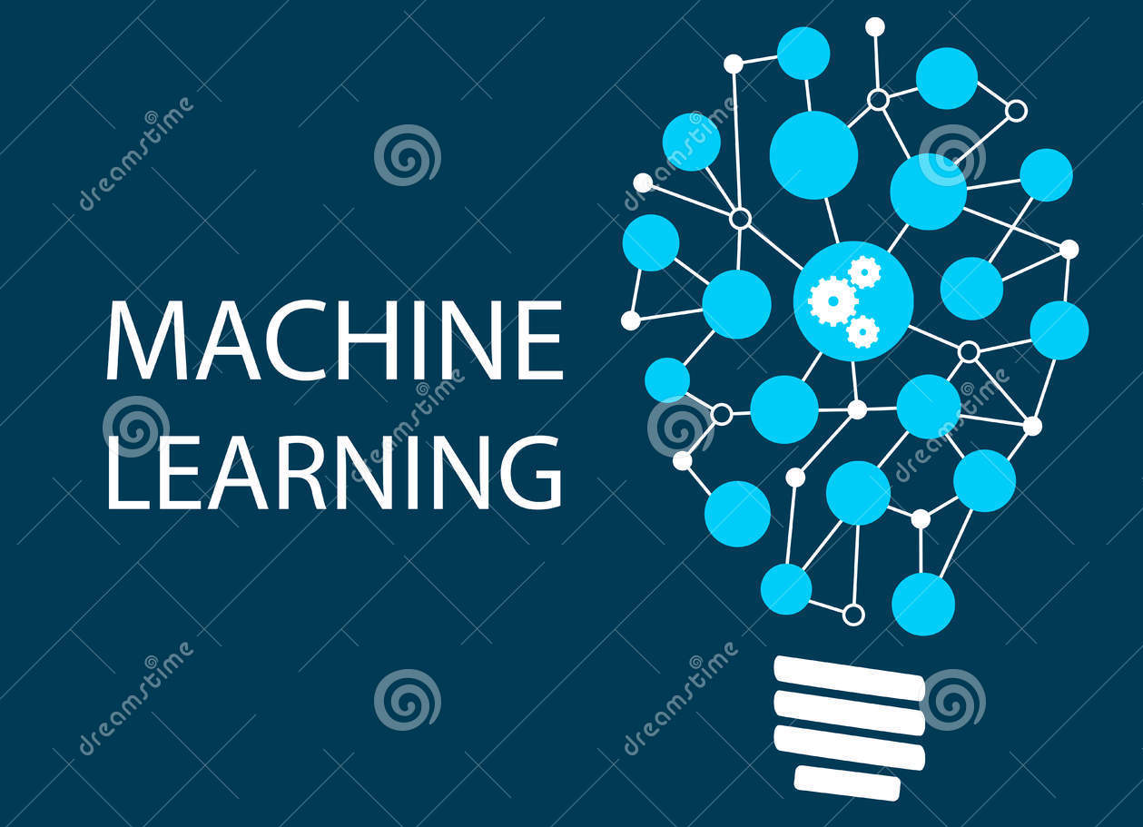
Course - 《Python与机器学习》- 礼欣
Course Page:
www.python123.org

Slide 42
Book -《Machine Learning》- Zhihua Zhou
Publishing house: Tsinghua University Press
Homepage: http://t.cn/RXvpCKB

